Slide 1
Art activities in Mental Health Week 2025
Mrs Dalby-Bellis shared an assembly with children across the school. They took part in activities across the week and had a mufti day on Friday to raise money.

Slide 2
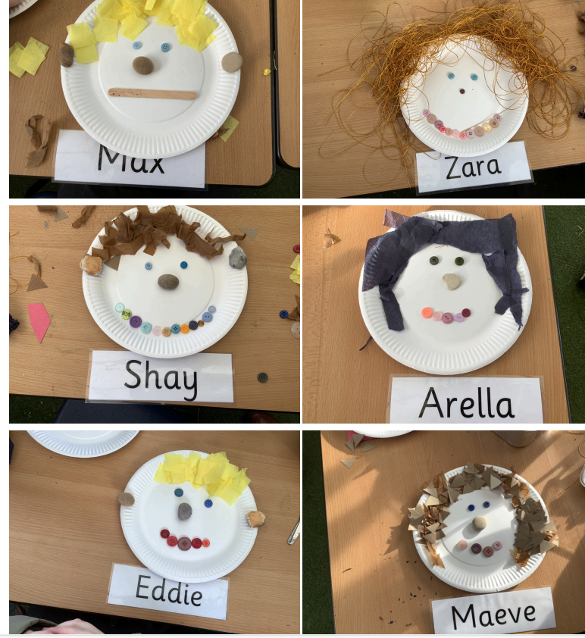
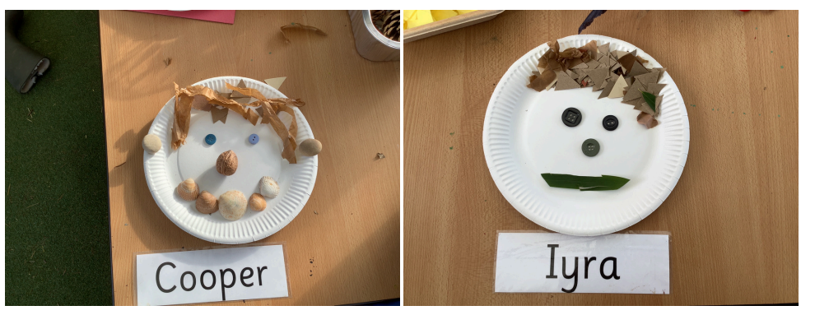
We made transient art self portraits.
We started by watching ‘What I Like About Me’ by Alloa Zobel Nolan.
Then we reflected on what we like about ourselves and our friends.
We then made some brilliant self portraits using a range of different materials.

Slide 3
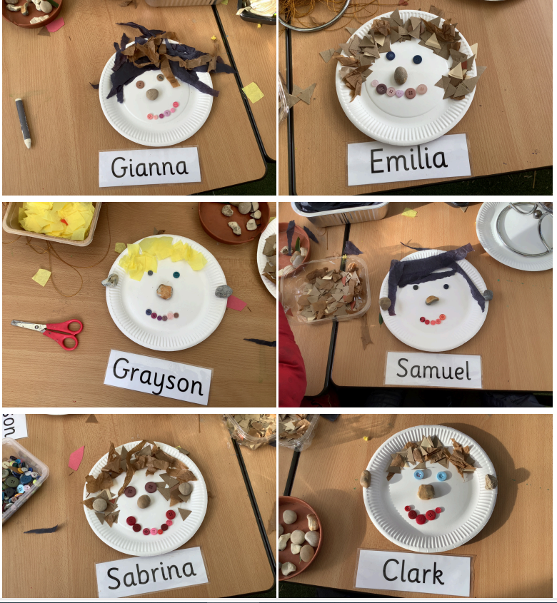

Slide 4
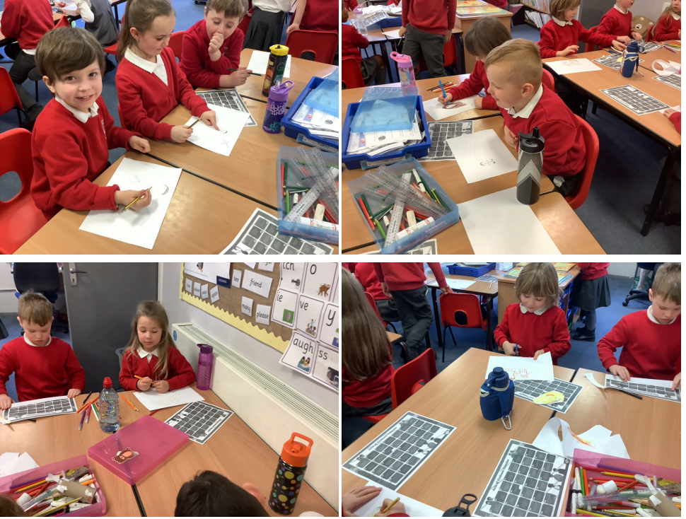
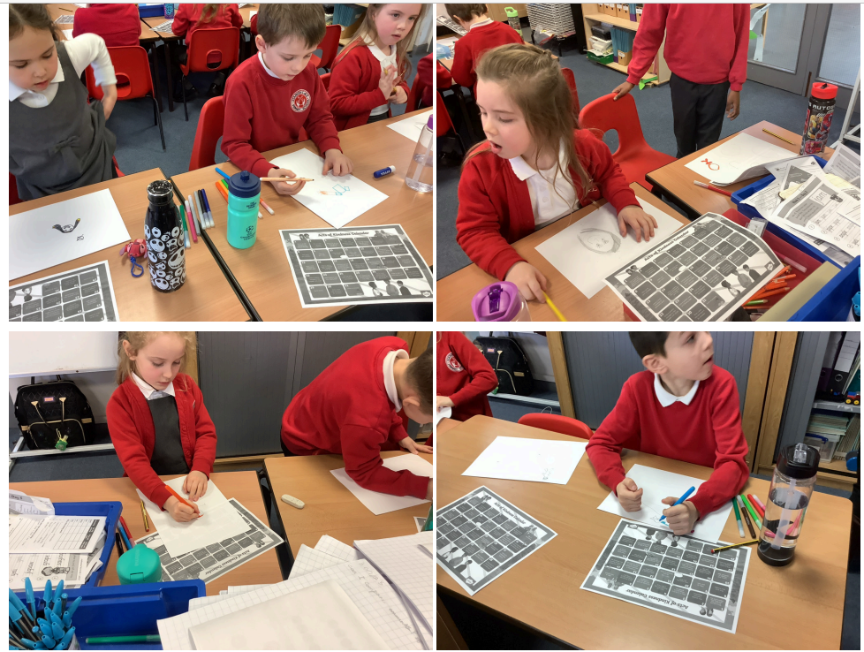
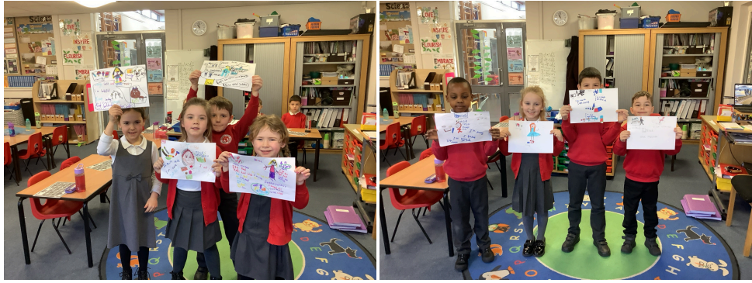
We named some feelings and talked about how they affect our bodies. We explored some ways to regulate our feelings including exercise and calm breathing.
We thought about the personality islands in Inside Out and what would be on our personality islands. We drew our own islands.
We added some positive affirmations about ourselves to our art work.
We then drew a self portrait, thinking about what makes us unique, and added this to our poster.

Slide 5
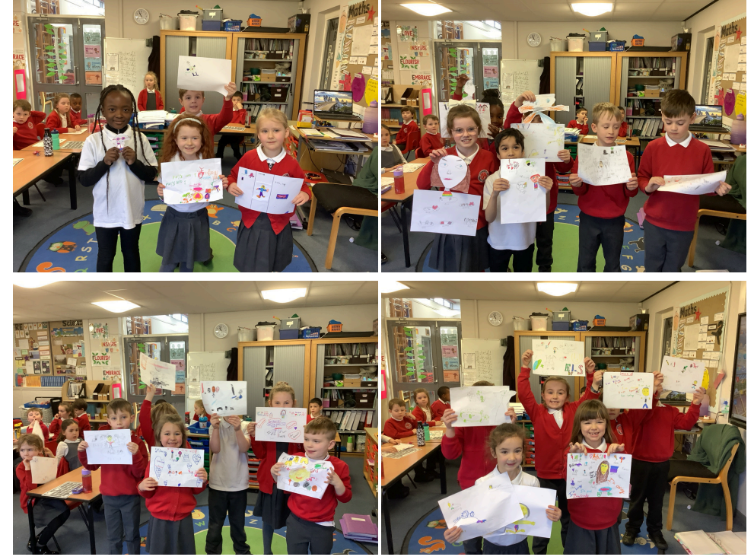

Slide 6
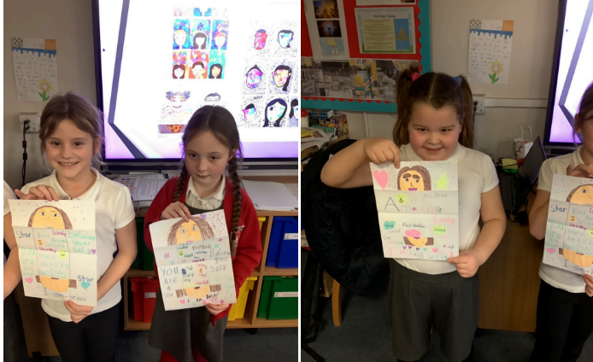
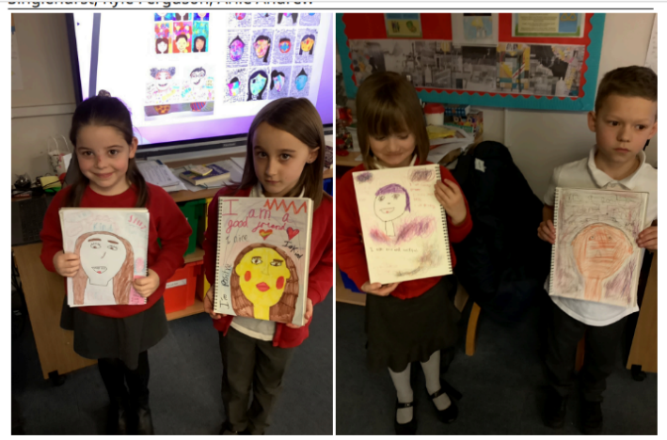
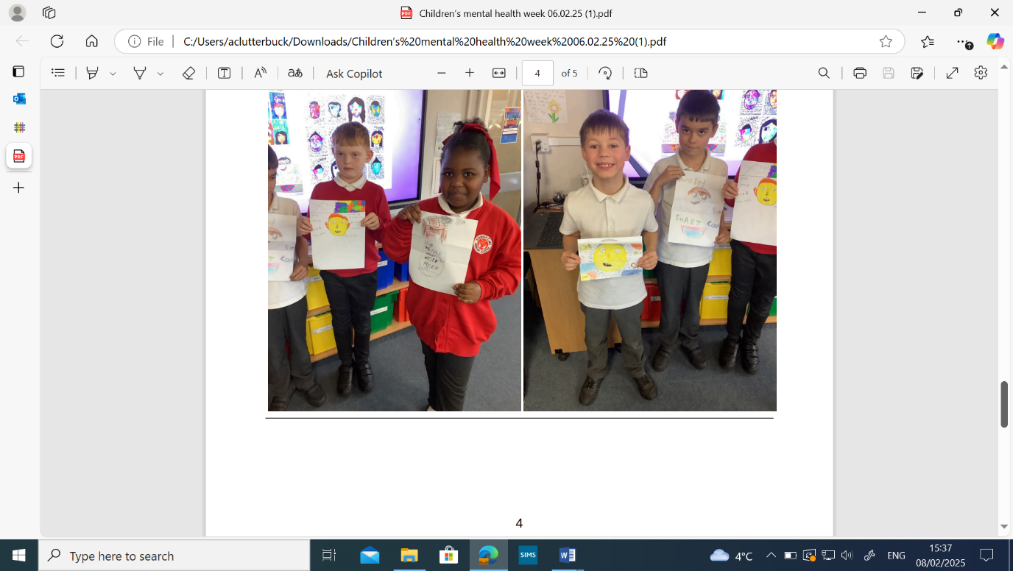
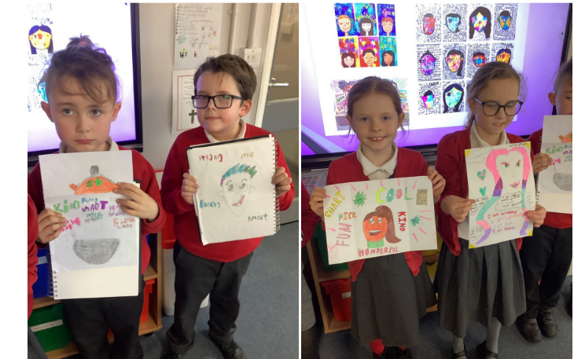
To think about this theme we thought about positive affirmation and how being positive can help us.
We then created a positive portrait of ourselves surrounded by positives about ourselves.

