Slide 1
Maths
September 2025

Slide 2
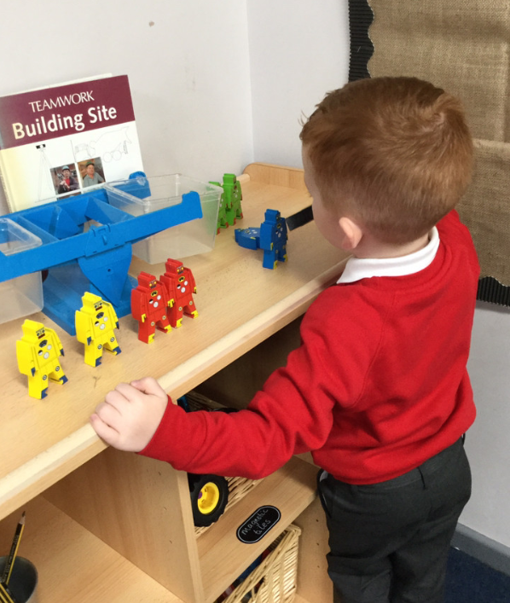
Maths in Reception
In Early Years, children develop a firm mathematical foundation in a way that is engaging, and appropriate for their age.
Maths is accessed throughout the classroom both inside and outside.

Slide 3
White Rose Maths
The scheme is divided into ten key phases and provides a variety of opportunities to develop their understanding of number, shape, measure, and spatial thinking.
In Early Years there is a strong focus on early number. Children need a really strong sense of numbers to 10.
This includes:
  Understanding the link between numbers and quantity (representing in different ways)
  Investigating how quantities are composed of smaller parts (6 can be two 3s or three 2s or 4 and two 1s)
  Knowing how numbers relate to one another and being able to compare and order them
  Exploring how quantities change when you add more items or take items away
Notes:
https://whiteroseeducation.com/parent-pupil-resources/maths/maths-with-michael#watch - Link to video for parents – up to you if you think if it is worth showing.

Slide 4
Teaching to develop:
Fluency
Reasoning
Problem Solving
A love of maths!

Slide 5
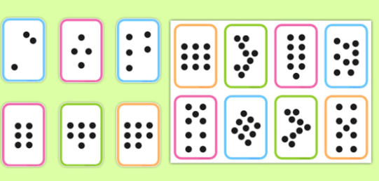
What is fluency?
Fluency is the ability to quickly recall addition, subtraction, multiplication, and division maths facts through conceptual learning, fact strategies, and memorisation.
We often refer to the skill of subitising when developing fluency.

Slide 6
What is reasoning?
Reasoning in maths is the children’s ability to explain their thinking.
Children often work in groups and partnerships to enable them to have lots of practice with this.
Other examples of teaching ‘reasoning’ in whole class sessions or play are spotting mistakes and explaining.

Slide 7
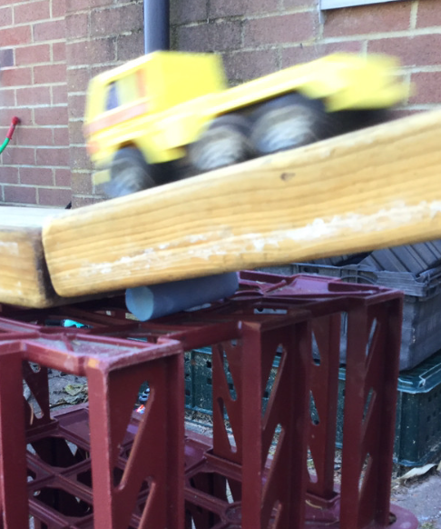
What is problem solving?
Problem solving allows children to use their maths skills in lots of contexts and in situations that are new to them.
It allows them to seek solutions, spot patterns and think about the best way to do things rather than blindly following maths procedures.

Slide 8
How we teach Maths in Reception
Maths happens both indoors and outdoors through a wide range of practical activities using lots of concrete resources.
Children are taught in a whole class carpet session focused on a particular area of their learning.
Children then have the opportunity to practise those skills and choose from different indoor and outdoor activities all based around the skill they have just learnt.
Child initiated play
Adult led group tasks

Slide 9
ELG: Number
Children at the expected level of development will:
Have a deep understanding of number to 10, including the composition of each number;
Subitise (recognise quantities without counting) up to 5;
Automatically recall (without reference to rhymes, counting or other aids) number bonds up to 5 (including subtraction facts) and some number bonds to 10, including double facts.

Slide 10
ELG: Numerical Patterns
Children at the expected level of development will:
Verbally count beyond 20, recognising the pattern of the counting system ;
Compare quantities up to 10 in different contexts, recognising when one quantity is greater than, less than or the same as the other quantity;
Explore and represent patterns within numbers up to 10, including evens and odds, double facts and how quantities can be distributed equally.

Slide 11
What can you do at home?
Point out where Maths exists in real life to support children with mathematical language and to help their understanding.
What shapes can they see?
Which size saucepans do we need for cooking?
When walking past houses on the way home from school, what is happening to the door numbers? Are they getting bigger or smaller ?
How much pizza has been eaten?
Count the pairs of socks on the washing line.
Measuring themselves.
Allow them to play in the bath with different sized containers.
Let children make up their own games and decide how to score points
Counting objects can be made from Lego, small figures, rubber ducks, buttons, coins
Building blocks are great for talking about measurement, the difference between 2 numbers, adding blocks
Their fingers! Encourage them to count on and count back, add and subtract using their fingers.
Ask questions such as “How many more?”, “How many altogether?”, “How many would I have if ?”
Deliberately make mistakes

Slide 12
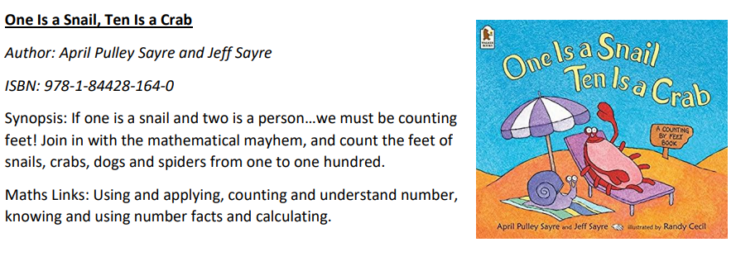
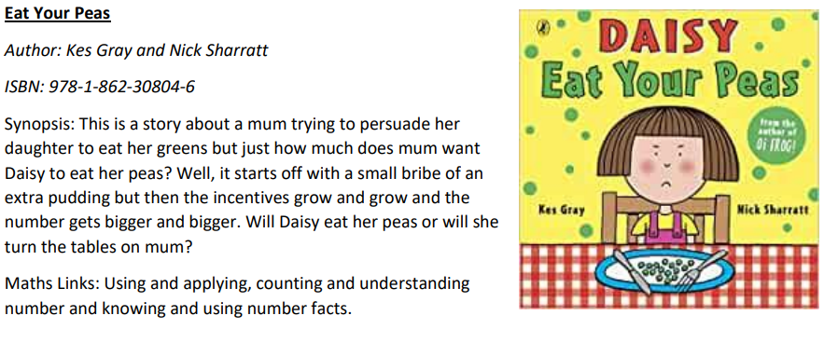
Story ideas!

