Slide 1


Slide 2
Spirituality at Stanion Church of England Primary School
What does it mean to be spiritual?

Slide 3
It is the experiences we have had that have had an effect on our lives, and the values that we live by.
Spirituality is often hard to explain but my definition is that it is a belief in something beyond ourselves. This can be linked to Religion and God but also the ‘Awe and Wonder’ of the natural world.
It is a feeling or a belief that we are part of a wider community. It is the way we view life and the relationships we have with different people. It is how we link with and explore and understand nature.
The feeling or sense that there is something beyond the self. A connection to nature and the world around. An awareness of self and our connections.

Slide 4
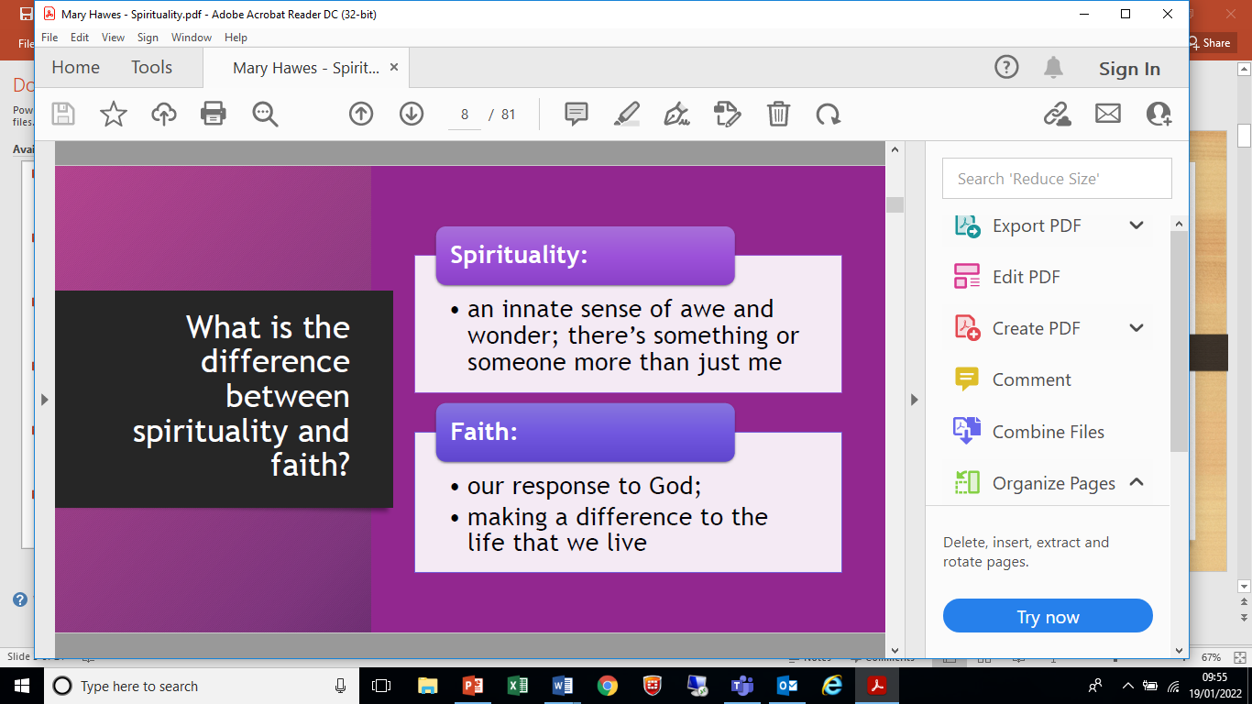

Slide 5
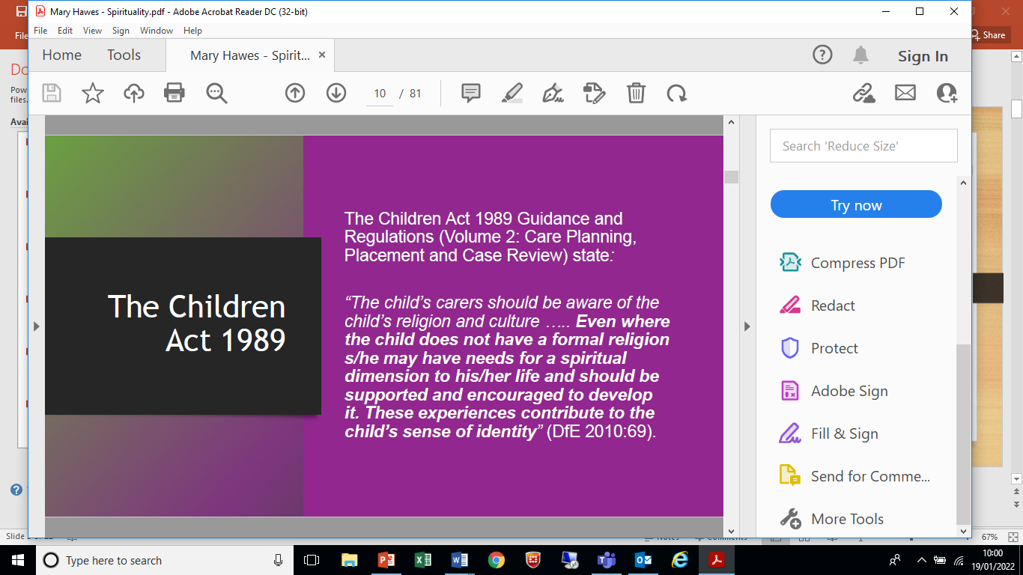

Slide 6
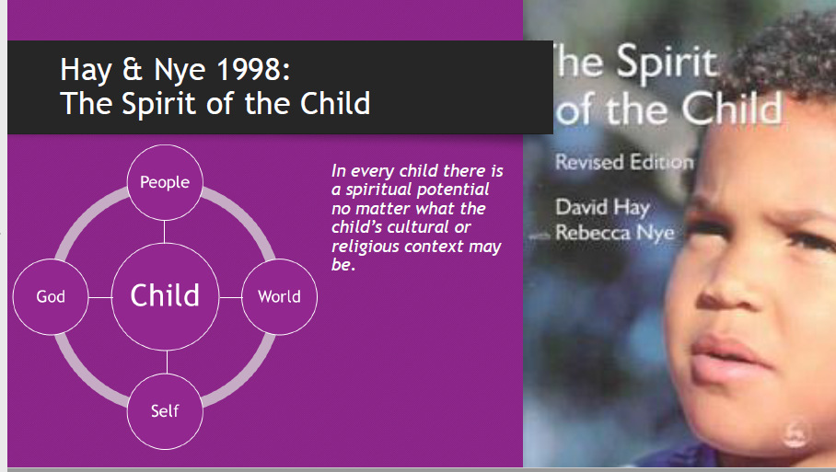

Slide 7
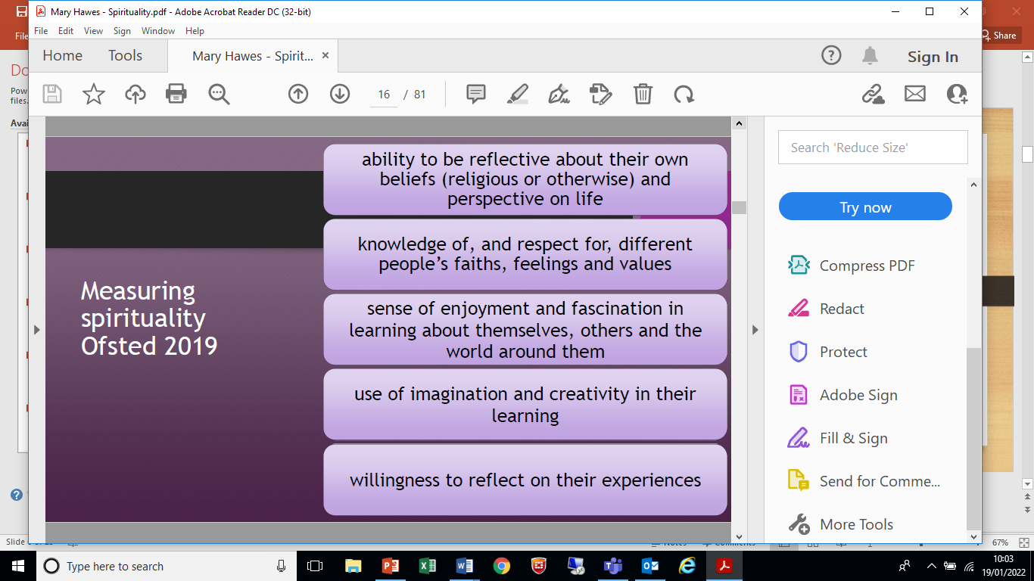

Slide 8
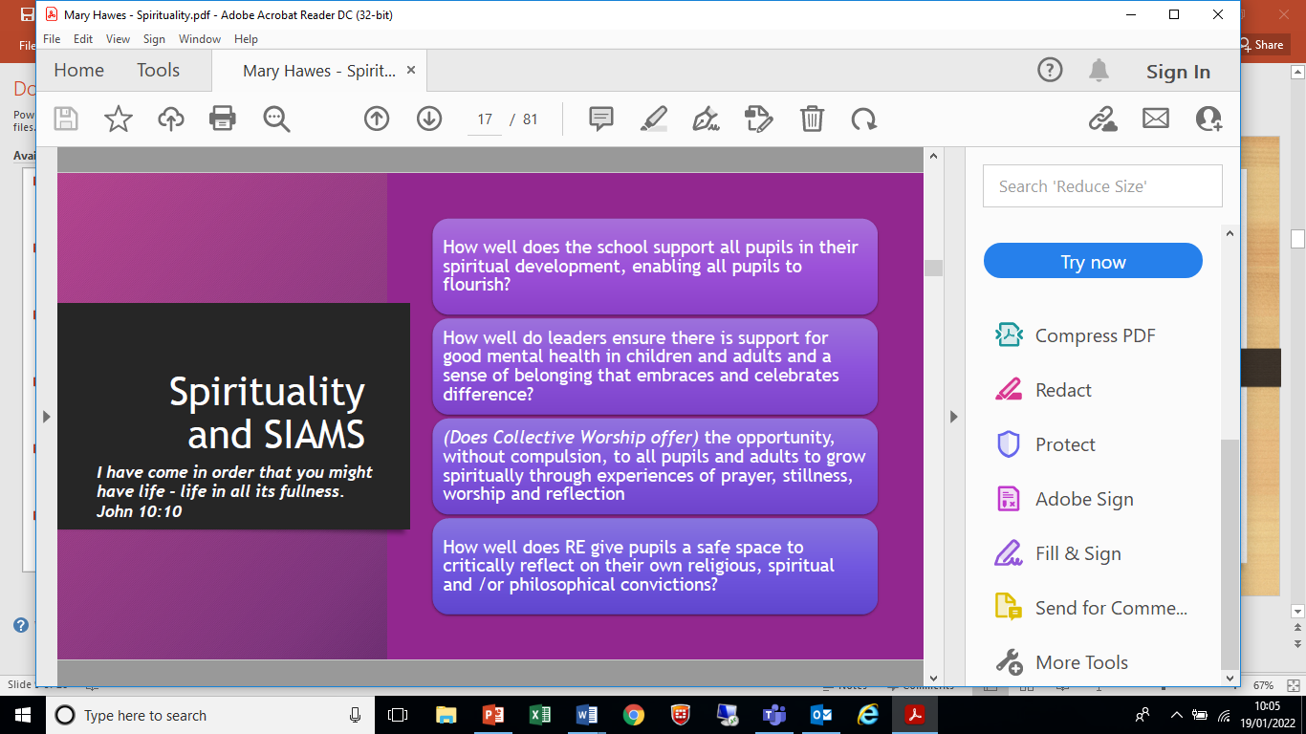

Slide 9
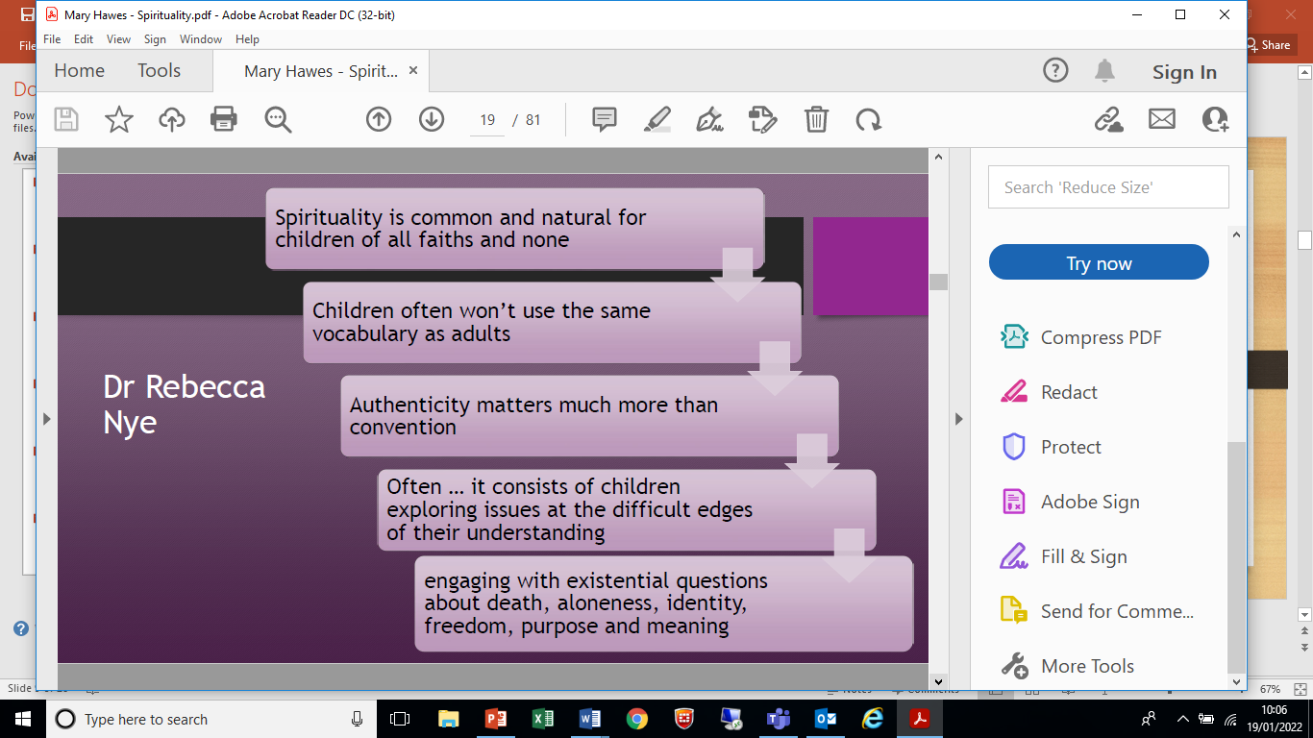

Slide 10
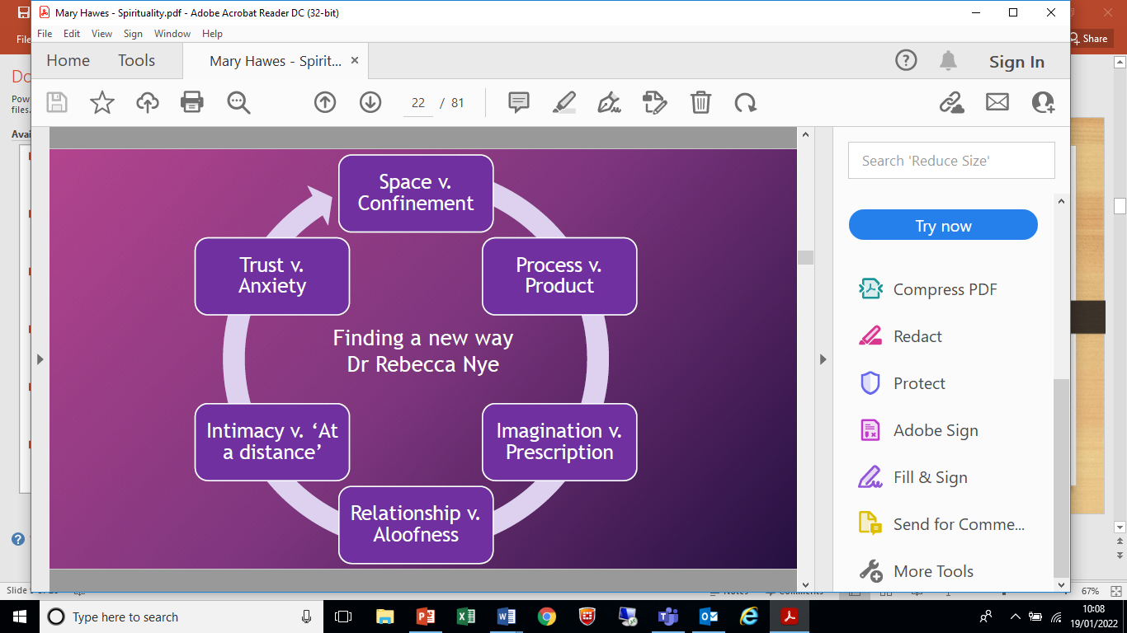

Slide 11
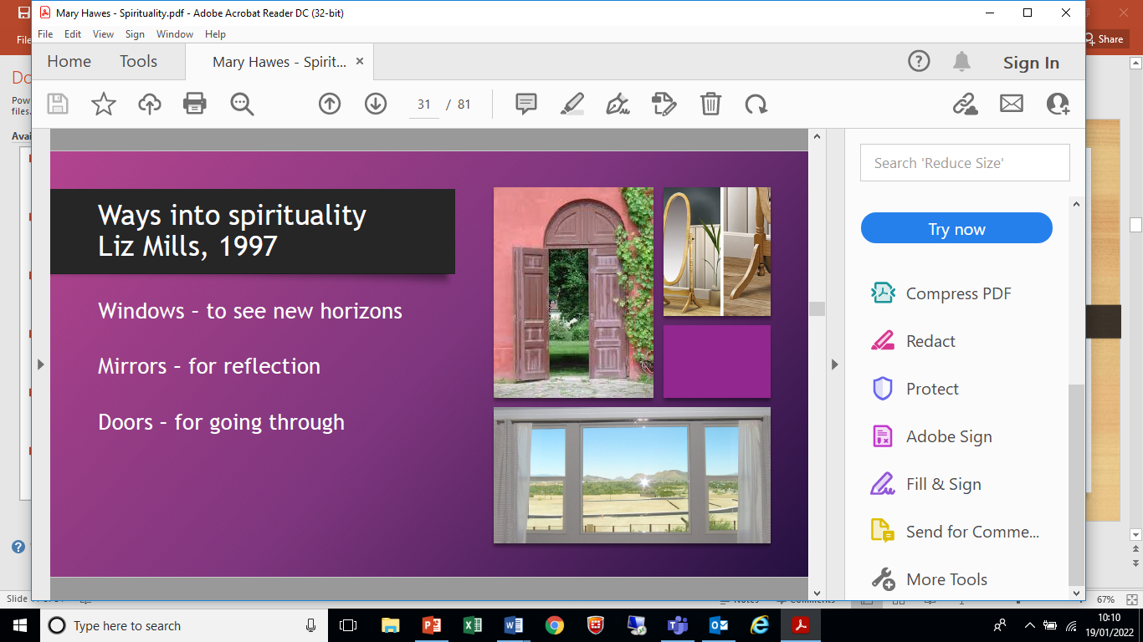

Slide 12
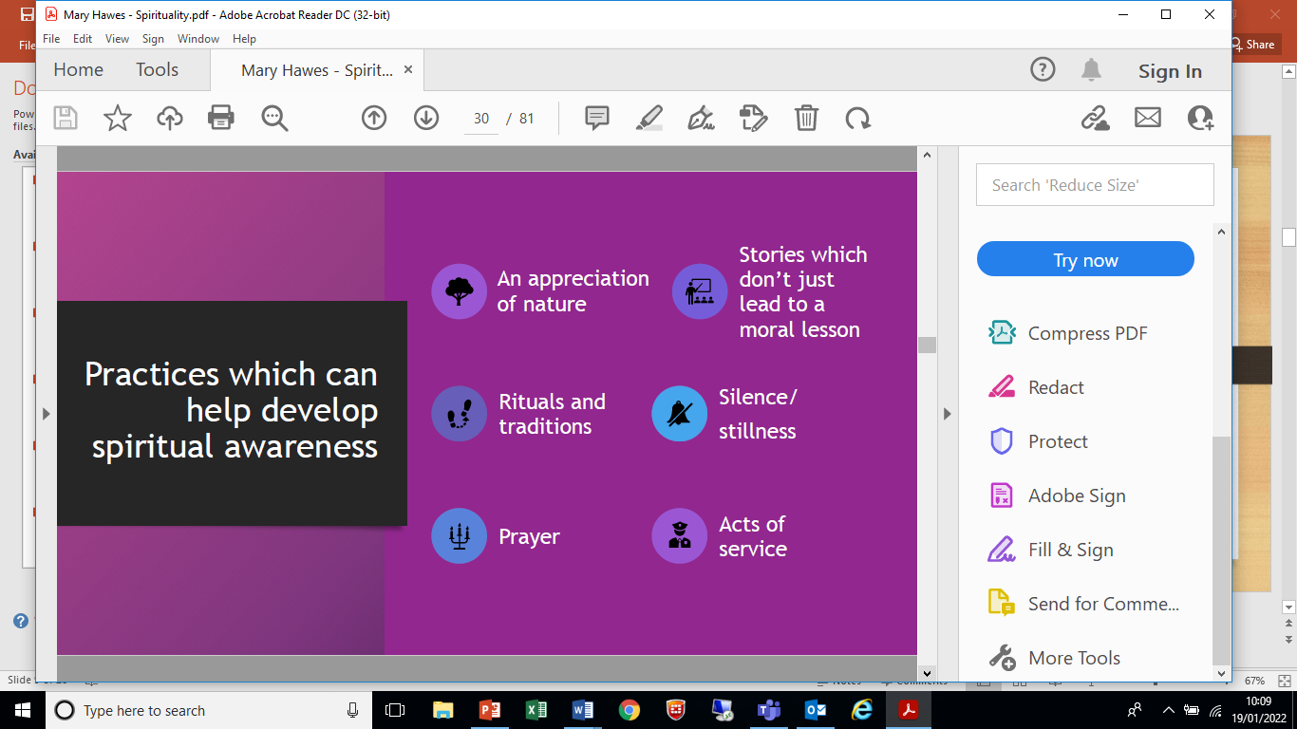

Slide 13
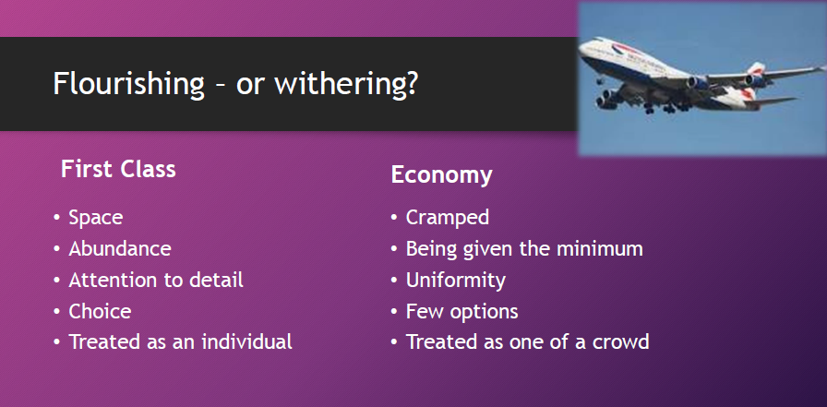

Slide 14
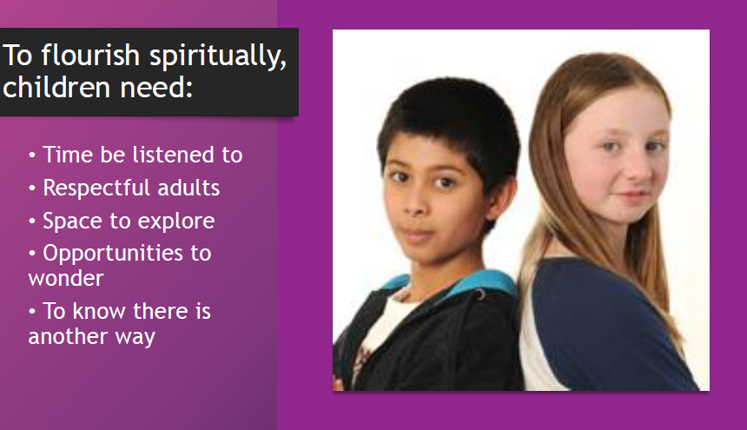

Slide 16
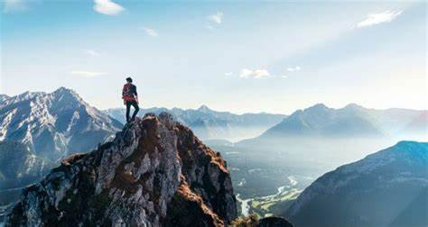

Slide 17
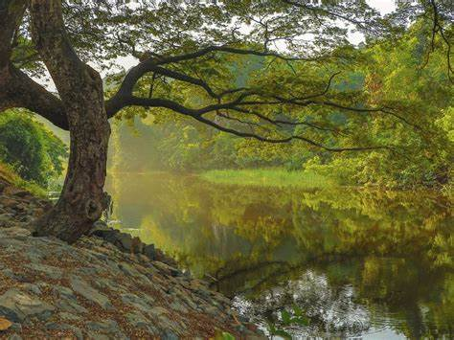

Slide 18
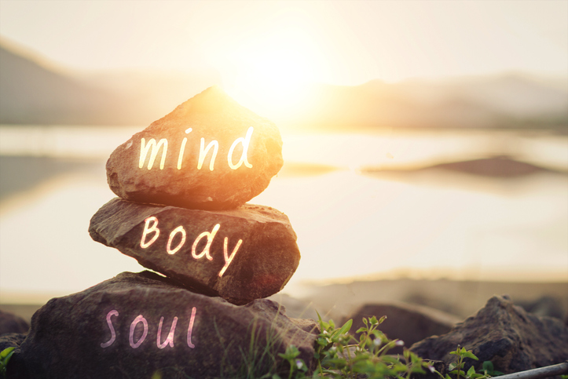
Spirituality is an awareness of something greater than you.
It embraces the way that we value life.
Spirituality is an awareness of something deeper.

Slide 20
Spirituality is… WOW
Sometimes we can have wow moments which make us realise that there are wonderful things all around us that take our breath away, and make us think of things that are greater than we are.
We might look at something and feel a sense of awe and wonder.
Can you think of any time in your life that this has happened to you?

Slide 21
Spirituality might be… OW
We might have moments when we see or experience challenges that make us think about others, and feel connected to other people in a whole range of ways.
Can you think of any time in your life that this has happened to you?
Have you ever opened your heart to help others?
Has a challenging moment ever made you think of something greater?

Slide 22
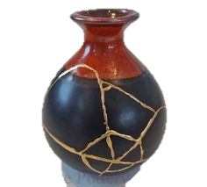
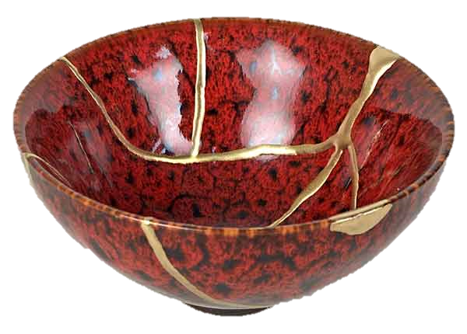
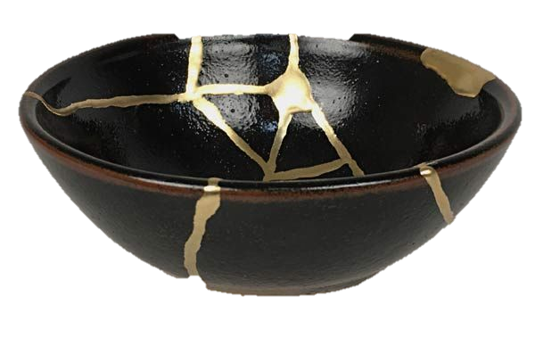
Kintsugi…
Sometimes when things go wrong, we can fix them in such a way that they become even better than before. How you respond to things can make life even better and more beautiful.
Have you ever done this?

Slide 23
Spirituality can be… NOW
It is really important to pay attention to how you are feeling NOW, and to take time to enjoy moments of joy and wonder that are happening RIGHT NOW.
It might be the joy of a piece of music, a painting or a beautiful moment in nature. It could be the words of a friend, a thoughtful moment of friendship or a loving gesture.
Sometimes our heads are so full of what has gone on in the past, or what might happen in the future that we forget to enjoy the present.

Slide 24
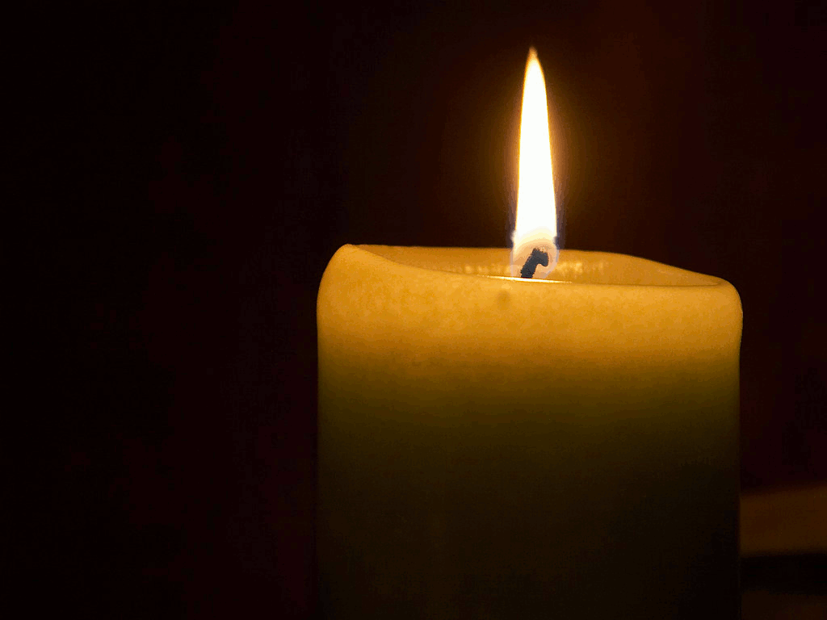
Time to reflect

Slide 25
Time to reflect
Help us to understand the importance of paying attention to our own feelings and to the feelings of others.
Help us to understand that true happiness is all around us, waiting to be discovered.
Help us to see the beauty of our world, and to do our best to look after the special place that we live in.
Help us to make the world a better place

Slide 26
Love your neighbour as yourself
Being spiritual is all about those WOW moments,
those OW moments
those NOW moments.
It is also about connecting with each other, caring for our world and showing love every day.
Stanion Primary School: Love, Inspire, Flourish, Embrace

Slide 27
Prayer
Mysterious God,
Most of the time we can explain what happens in the world by science
But sometimes we may see a glimpse of something beyond:
The joy of making a new friend,
The excitement of being able to do something today which we couldn’t do yesterday,
The delight of warm sun on our faces or splashing in cold puddles.
In these wow moments, when we’re aware of something beyond, Help us to be open to the idea of you, God.
Comforting God,
Most of the time we feel safe and secure
But sometimes life can be difficult and painful and we long for something beyond:
Someone who understands what it’s like to be alone,
Or let down by friends,
Or feel like they have nowhere to call home.
In these ow moments, help us to be open to something beyond And brave enough to reach out and pray.
Constant God,
Most of the time we are busy running or learning or playing,
But sometimes it’s good simply to be, help us then to glimpse something beyond the everyday:
When we are still,
When we are present to ourselves, When there is nothing to distract us.
In these now moments, help us to be open your possibility God And help us to pray.

Slide 28
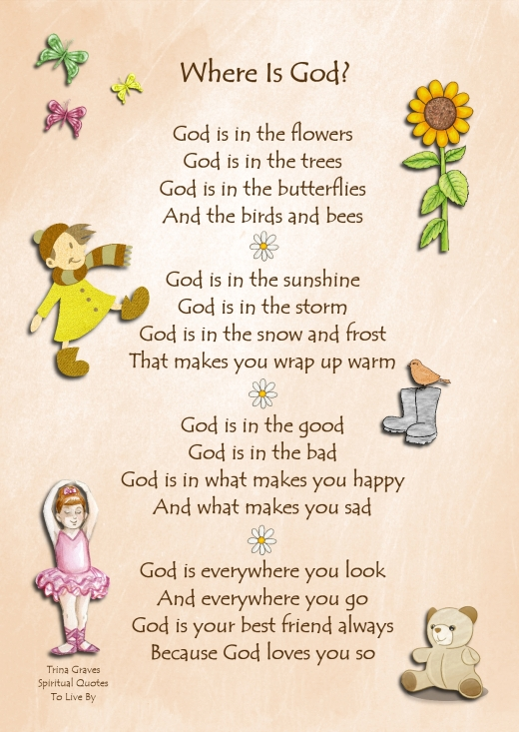
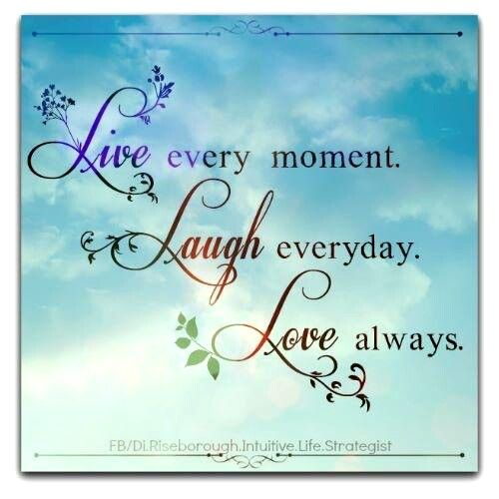

Slide 29
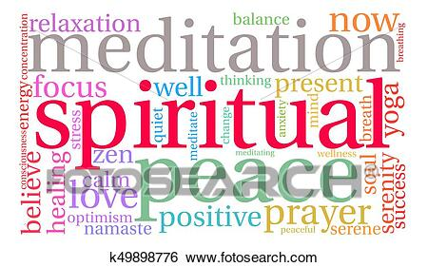

Slide 30
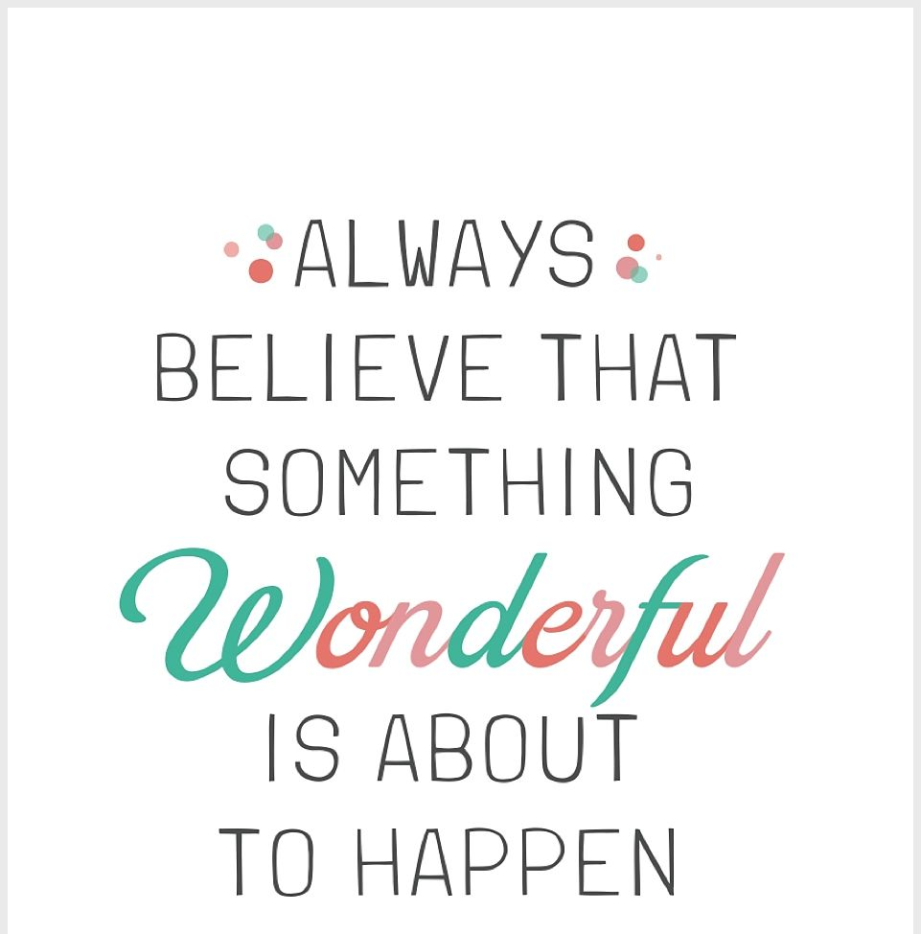
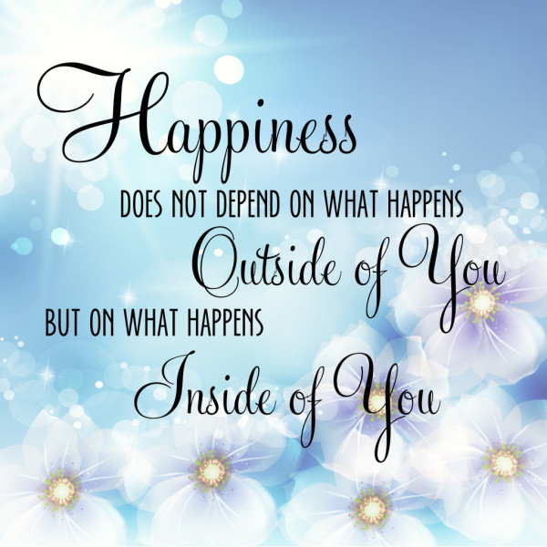

Slide 31
Spirituality project
Reception: Increase an awareness of myself and others
I am unique and special, my friend is unique and special
Awe and Wonder- ‘Magic pictures’
Look out of the window- what wow things can you see? Opening doors.
Y1 and 2: Increase awareness of our world and the beauty around us
Responding to beautiful music and pictures- reflect
Things that are difficult can be sorted out, and end up stronger and more beautiful than before, if we are open-minded and positive.
Torn pictures etc- put them back together, creatively and beautifully.

Slide 32
Spirituality project
Year 3 and 4
Responding to beautiful music and pictures
Create a picture that will inspire others to reflect-
can you think of a question to encourage that thought and reflection?
Write a prayer of relection.

Slide 33
Spirituality project
Year 5 and 6
The joy of…
The excitement of …
The delight of…
The pain of …
The bravery to …
The quiet of …
The chance to …

