Slide 1


















British values

Slide 2


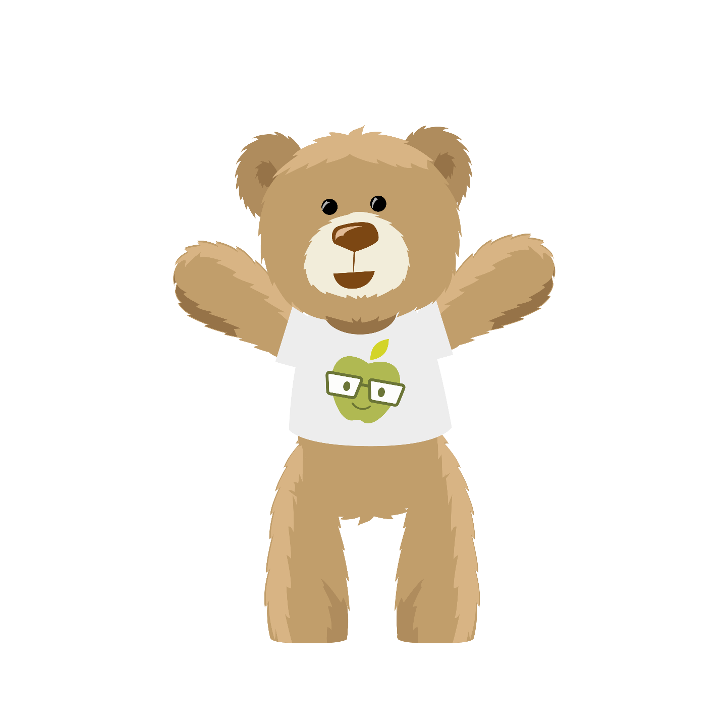
What do you think values are?
I think values are the beliefs, morals and standards of behaviour that are important in someone’s life.

Slide 3


So, what are British values?
Look at the posters on the next four slides, explaining each British value. Discuss Peter Bear’s questions and thoughts.

Slide 4
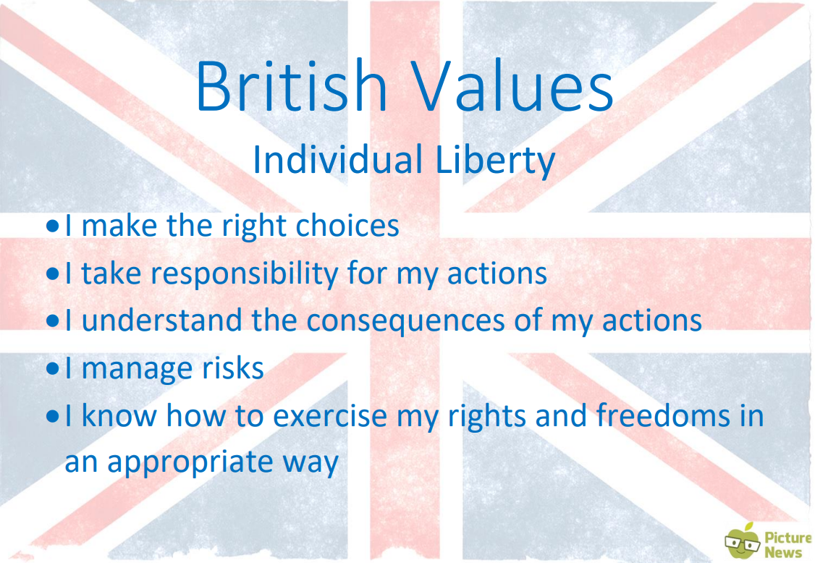

What do I do if I don’t think something is right or fair?

Slide 5
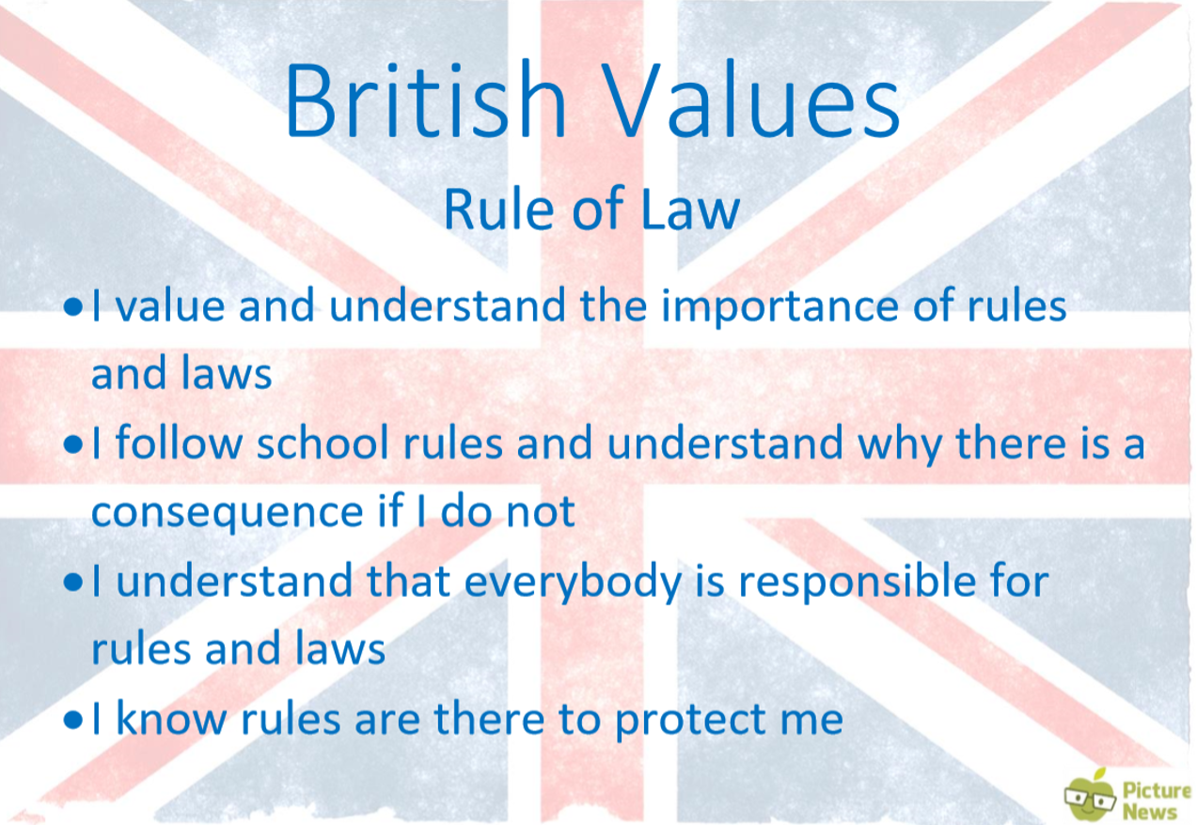

Do you know your school rules?
What happens if you break them?

Slide 6
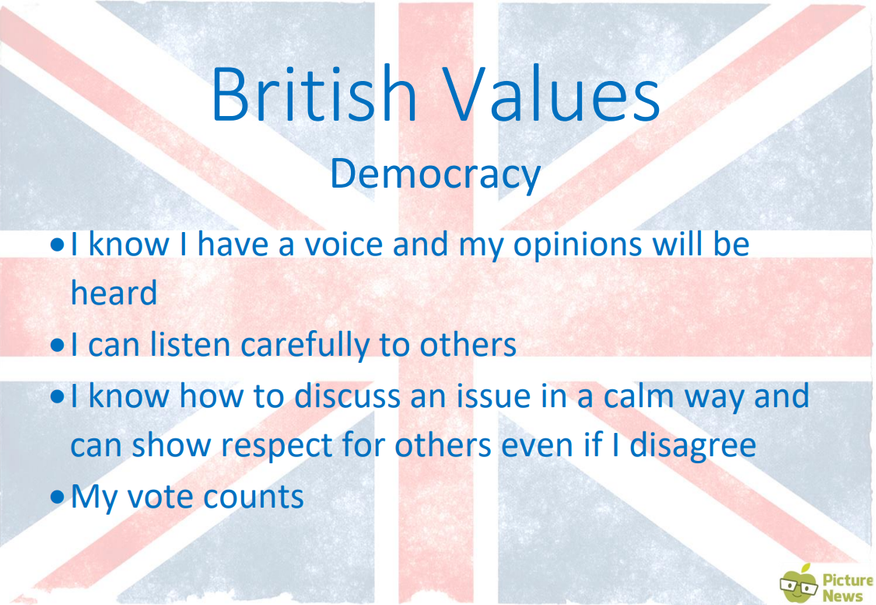
How is your voice heard?
How do you show you are listening?
What do I do if something makes me feel angry or frustrated?

Slide 7
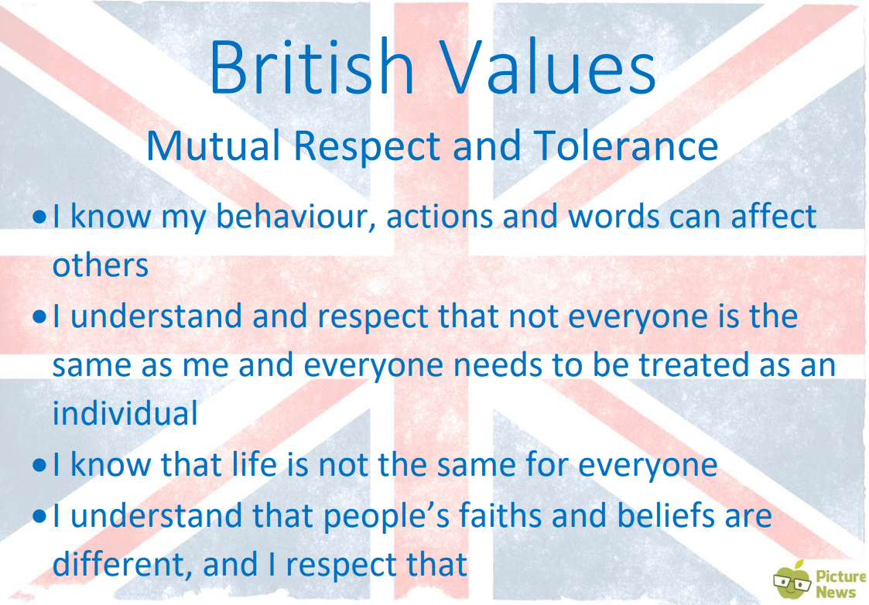
Can I be friends with someone who doesn’t believe the same things that I do?

Slide 8
Are your personal values similar or the same?
What about your school values?

Slide 9
What happens if we remove a value?
Watch the video by clicking on the link below and see!
Removing a British value (vimeo.com)

Slide 10
Which value was removed?
Can you act out what might happen if a different value was removed from your class?

Slide 11

Look at the acronym on the next page that might help us remember the British values.
What do you think it means?

Slide 12

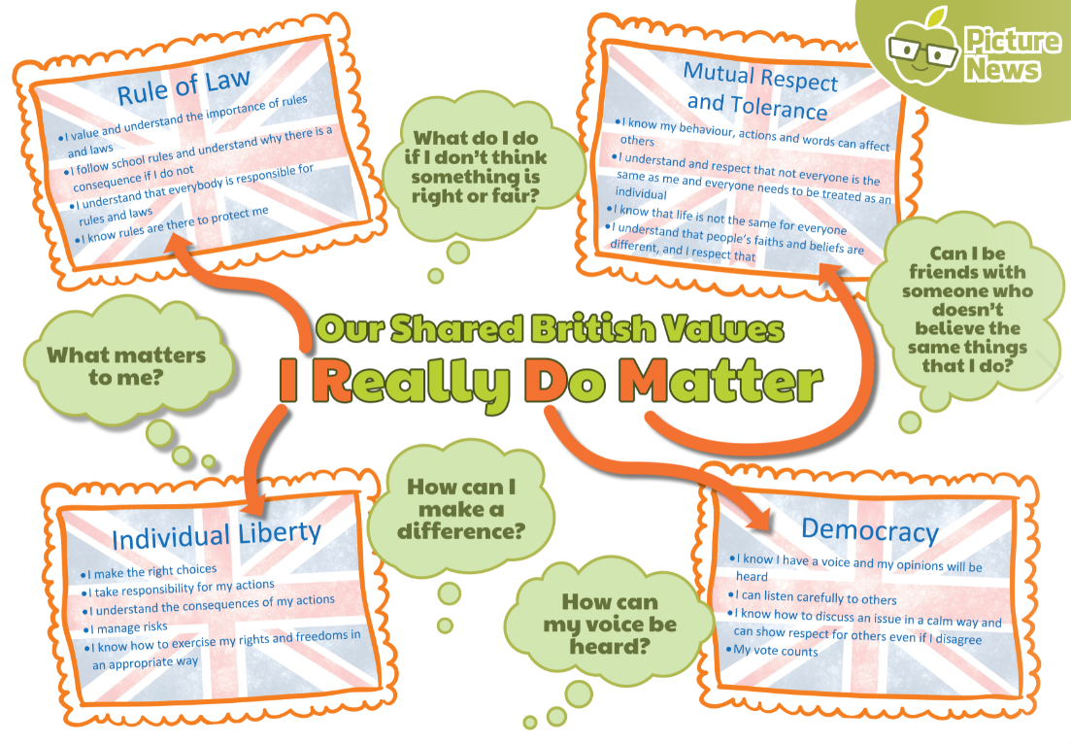

Slide 13
What does ‘I Really Do Matter’ mean?
I think it means that for us to live by these values in school, every single person matters, we all play our part and we are all very important.

Slide 14


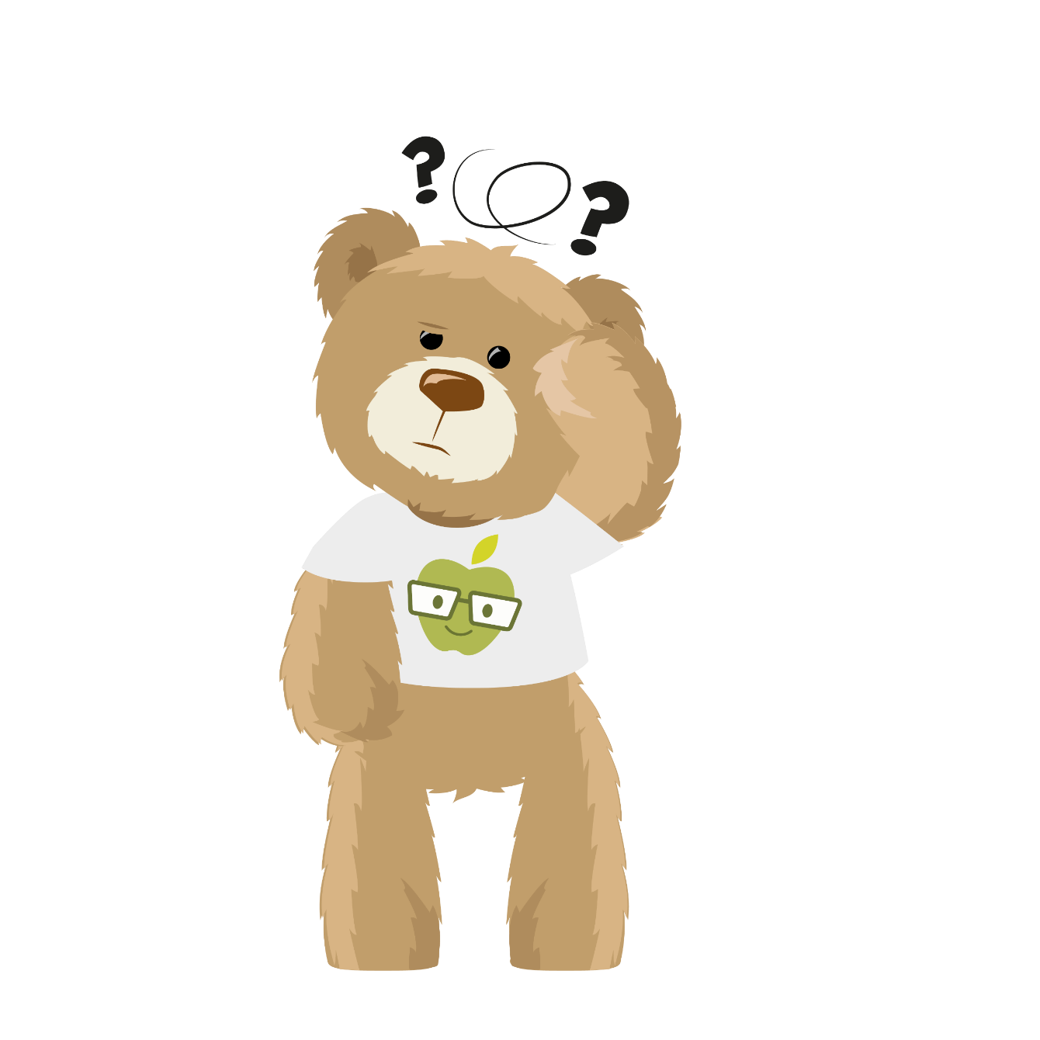

Do you live by British values at school?
Mutual Respect
and Tolerance
Rule of Law
I learn about other people’s faiths, religions and cultures at school
I know not everyone is the same and can celebrate differences
I know how to show someone respect
I follow class and school rules
I know what happens if I break the school rules
I know the difference between right and wrong
I can explain who enforces rule or laws
Why do we teach current affairs?
Individual Liberty
I have opportunities to vote in school
I know what the advantages and disadvantages of democracy are
I can disagree with someone without getting angry, upset or frustrated
I make choices at school such as my reading book, clubs, playground activities
I take responsibility for my own behaviour
School helps me to be confident and feel good about myself
My opinions and ideas are listened to in school
Democracy

Slide 15

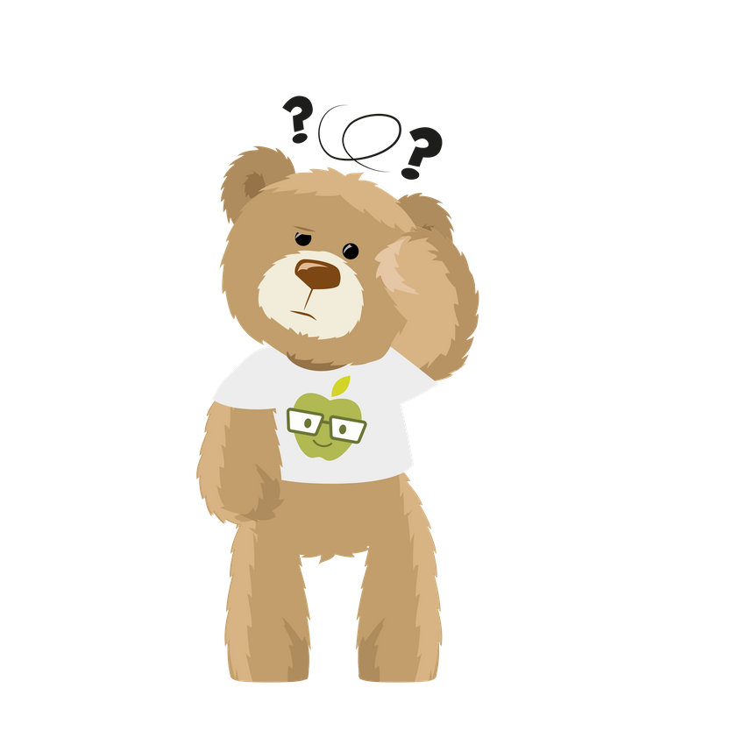
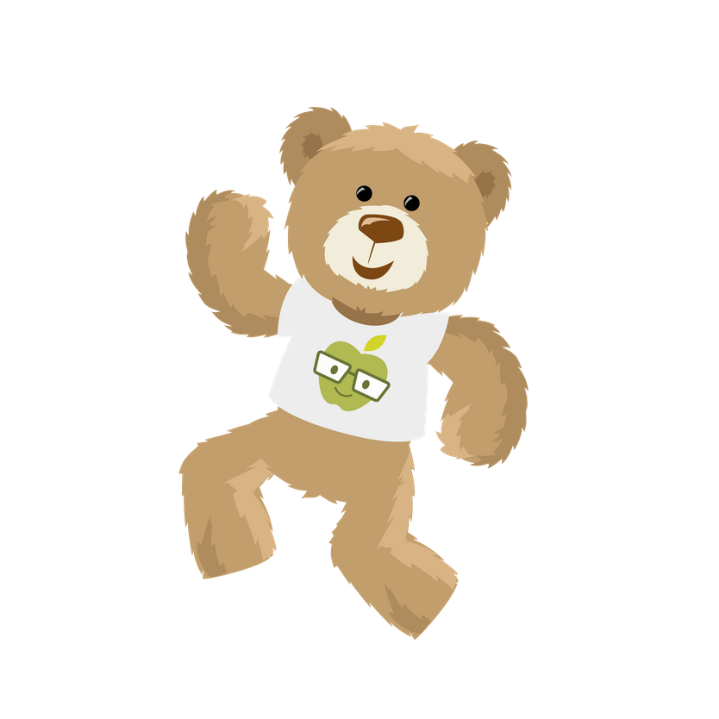
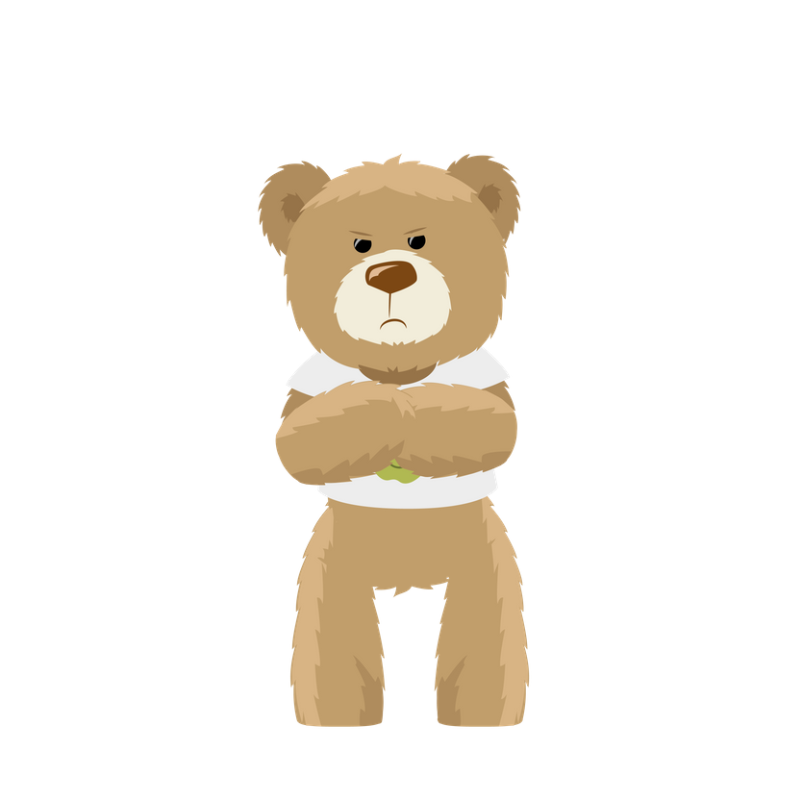
How does it make me feel?
sad | angry | happy | confused | excited | worried | shocked | afraid
despondent disconsolate dismal doleful downhearted forlorn gloomy melancholic miserable woeful wretched | aggrieved annoyed discontented disgruntled distressed exasperated frustrated indignant offended outraged resentful vexed | beaming buoyant cheery contented delighted enraptured gleeful glowing joyful | addled baffled bemused bewildered disorientated indistinct muddled mystified perplexed puzzled | animated elevated enlivened enthusiastic exhilarated exuberant thrilled | agitated anxious apprehensive concerned disquieted distraught distressed disturbed fretful perturbed troubled uneasy | astonished astounded disconcerted distressed dumbfounded horrified staggered startled stunned surprised | alarmed apprehensive daunted fearful frantic horrified petrified terrified

