Slide 1
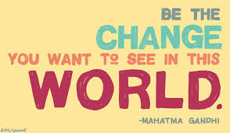
What does it mean to be an advocate for change?
Do you know anyone who has changed things for the better?

Slide 3
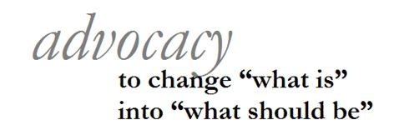

Slide 4

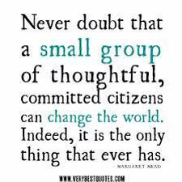

Slide 5
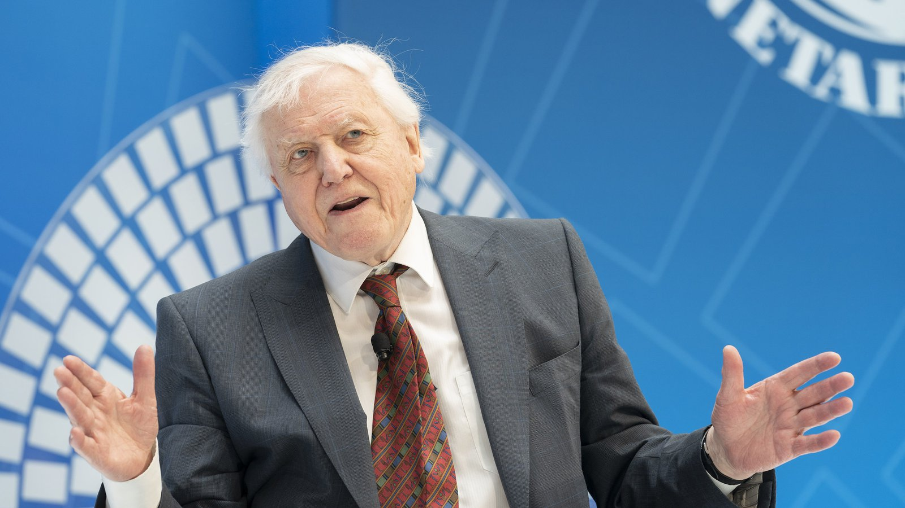
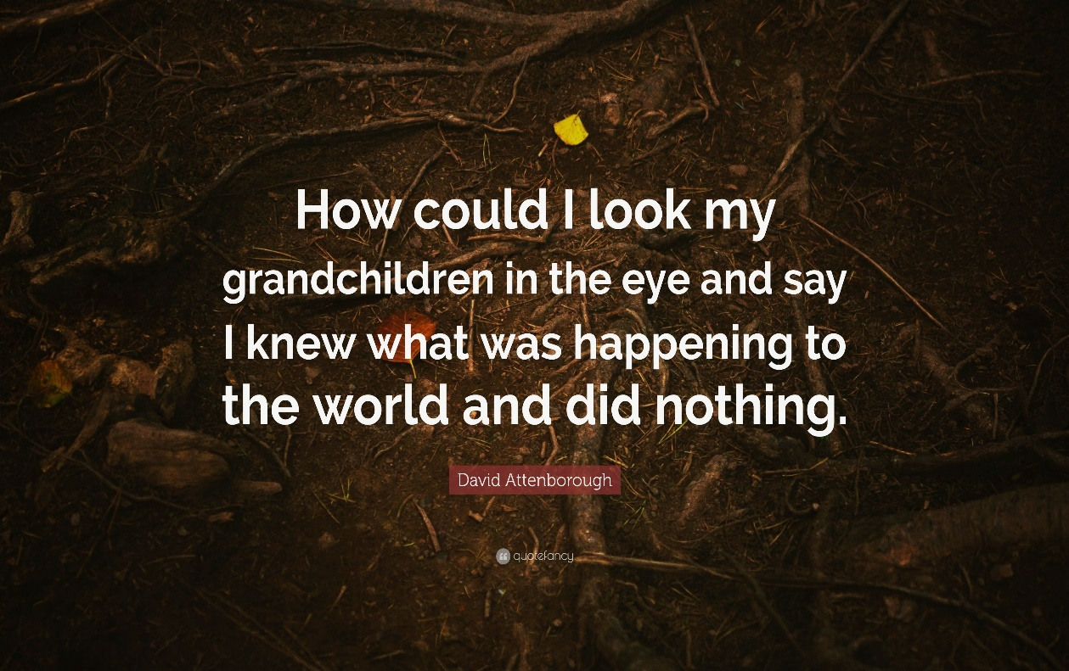
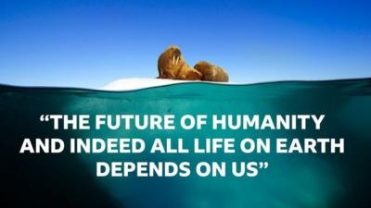

Slide 6
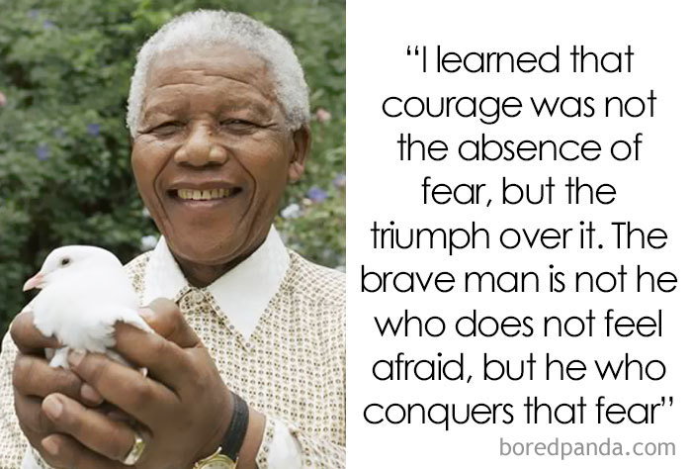

Slide 7

Tomorrow will be a good day.

Slide 8

Hi everyone,
Thank you so much for all of your interest in learning British Sign Language.
I cannot believe the Google search for learning sign language has gone up by 488%.
Thank you all so much.
AMAZING!

Slide 9
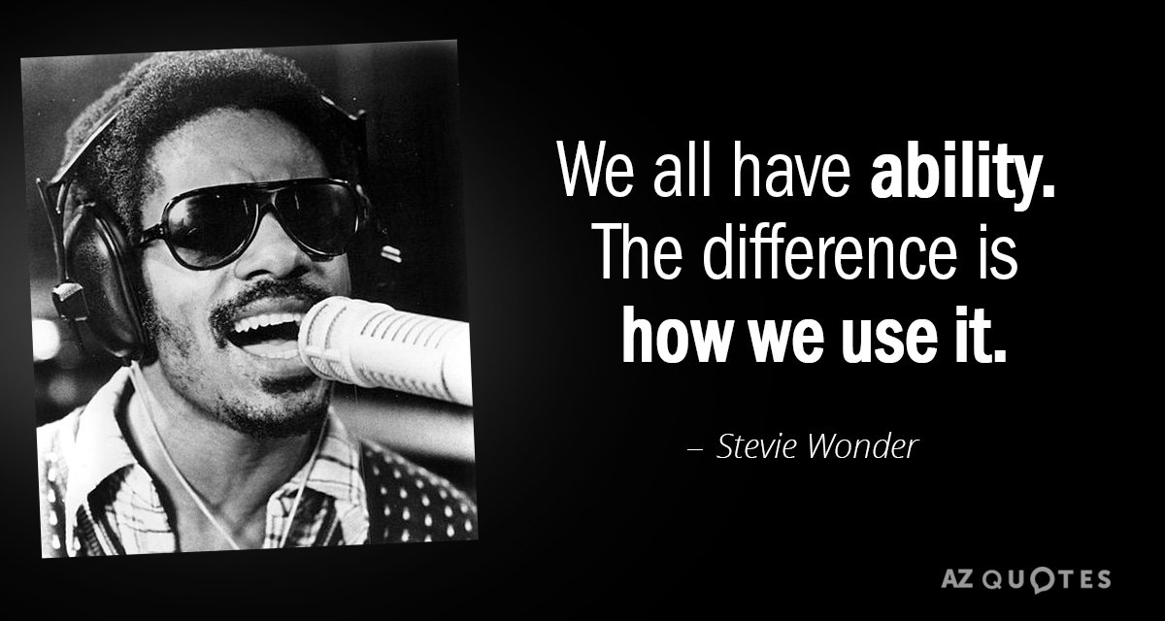

Slide 10
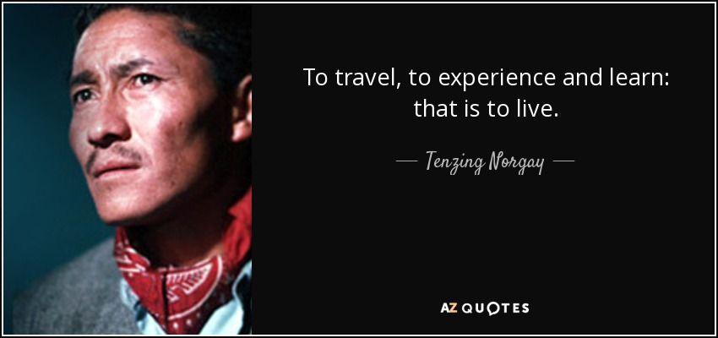

Slide 11
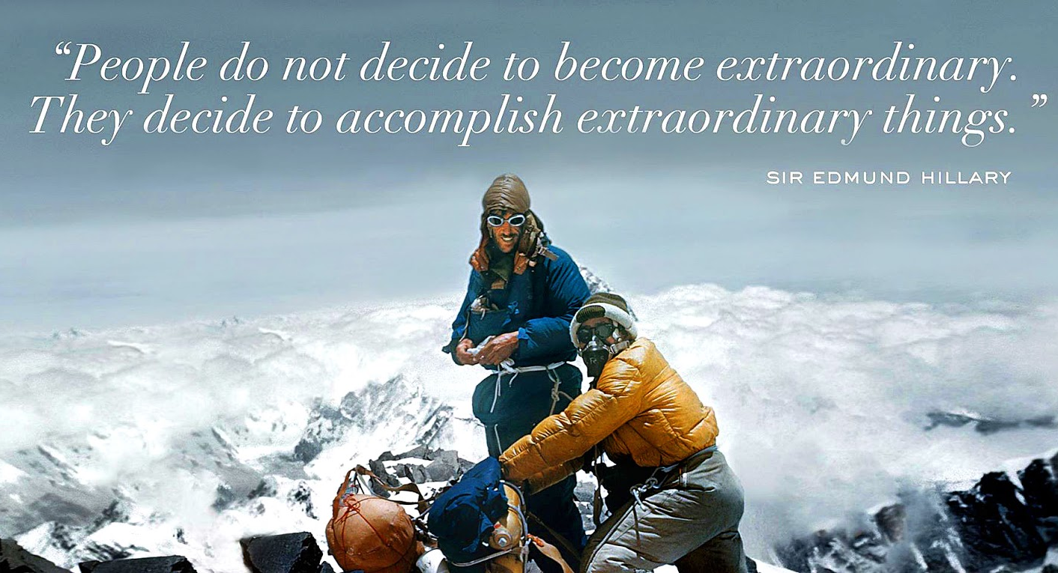

Slide 12
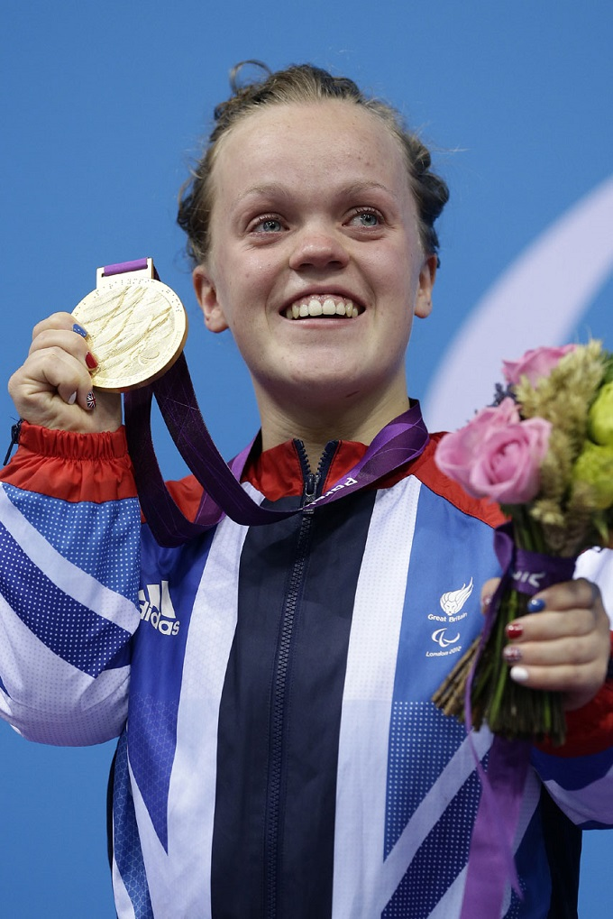
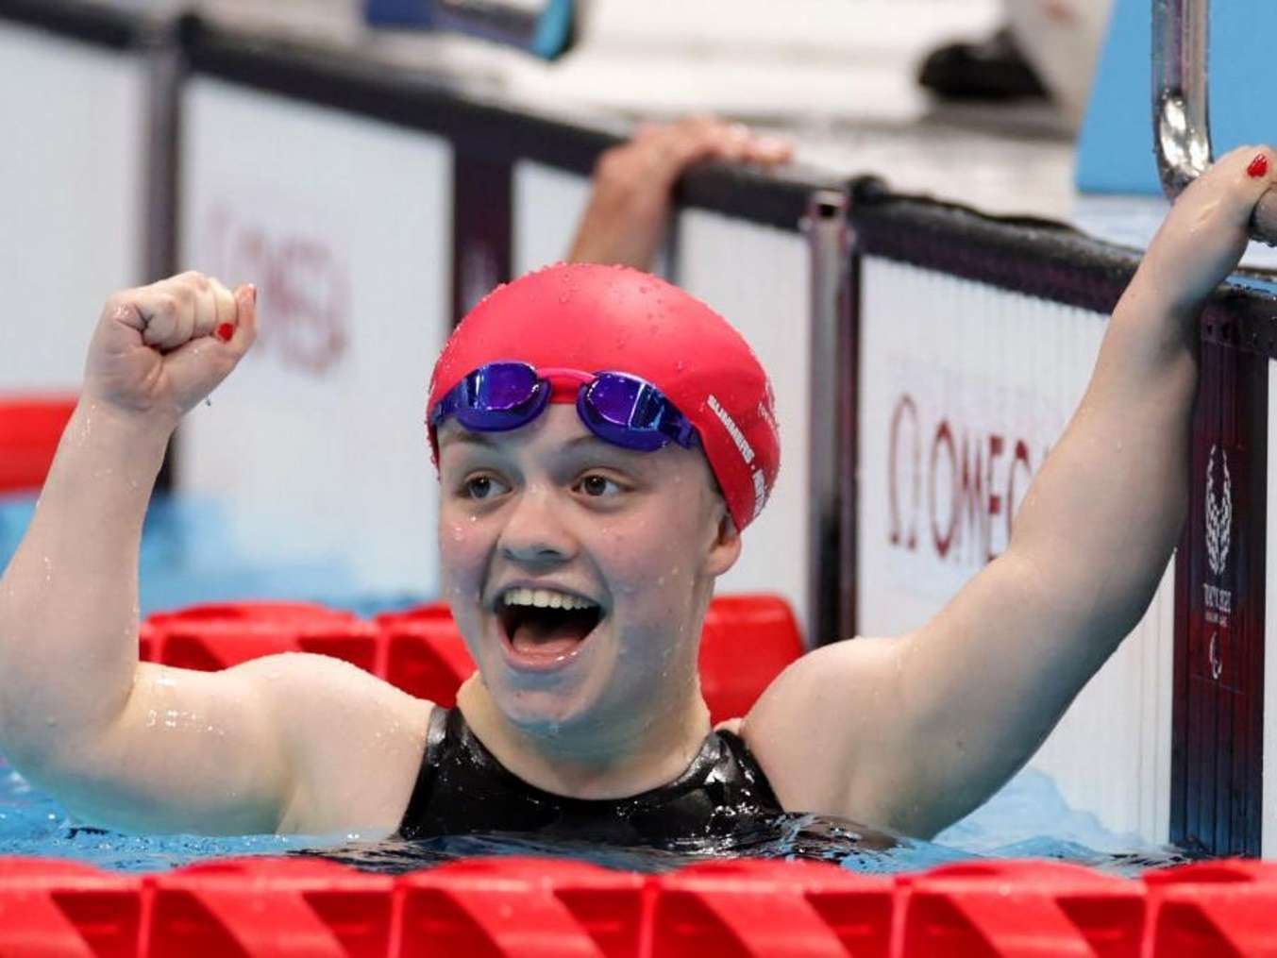
“Ellie inspired people like me.” Now Maisie herself is inspiring others.

Slide 13

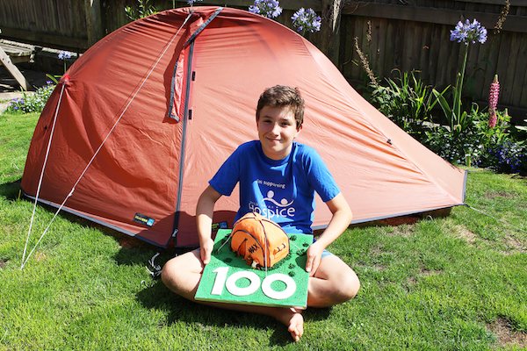

Max Woosey

Slide 14

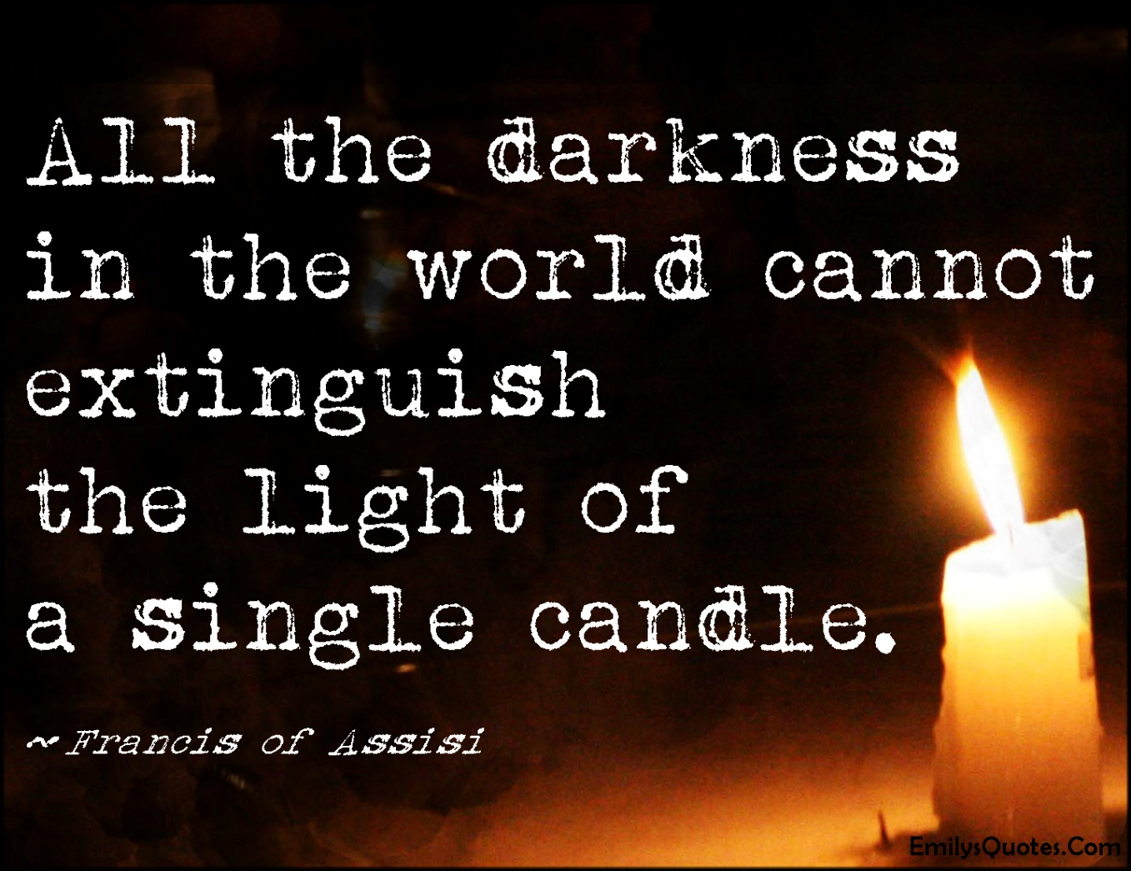
Always believe that you CAN make a difference.

Slide 15
Who do you think has been an inspirational advocate for change?
The church council are going to share some inspirational advocates for change…

Slide 16
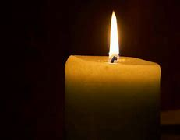
Time to reflect
Help us to see what is good in the world and value it.
Help us to see what needs to be changed and to feel that we CAN make a difference.
Thank you for all those people who have inspired change.

Slide 17


